Slide 1
PetFinder
Marguerite Morgan
Sunayna Jain
Murray Stokely

Slide 2
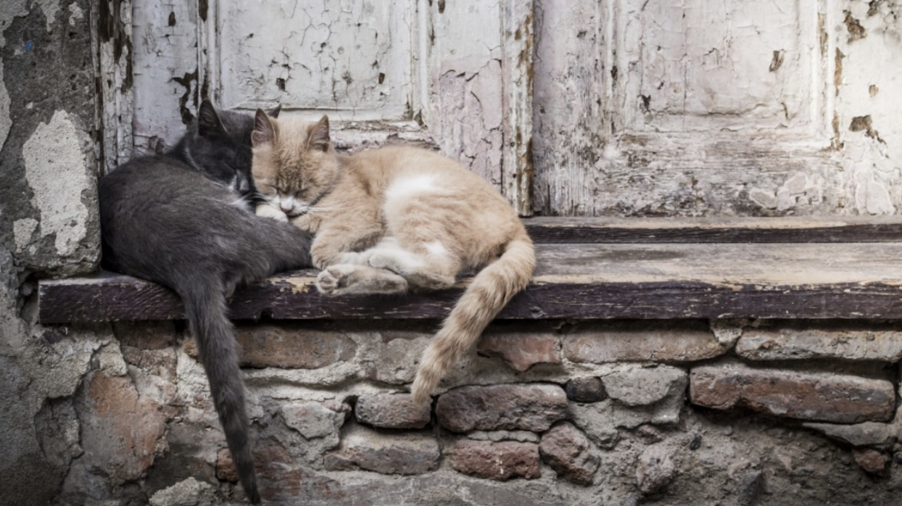
Pet homelessness is a large issue worldwide.
In the US alone, it’s estimated that ~6 millions animals enter shelters each year; 35% don’t get adopted and 15% end up being euthanized.
PetFinder.my formed in 2008 and has become Malaysia’s leading animal welfare program, finding homes for thousands of animals each year.
An animal’s photo is hypothesized to be a key factor in an animal’s likelihood of and speed to adoption.
Our objective is to build a model that predicts the popularity of a pet based on their photo in order to help PetFinder optimize animal images and ultimately find a home for the thousands of animals up for adoption on their website.
Image source

Slide 3
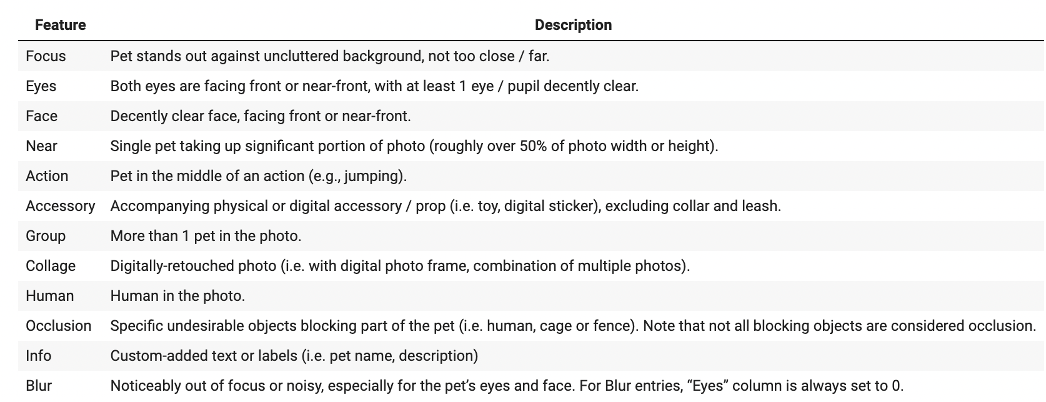
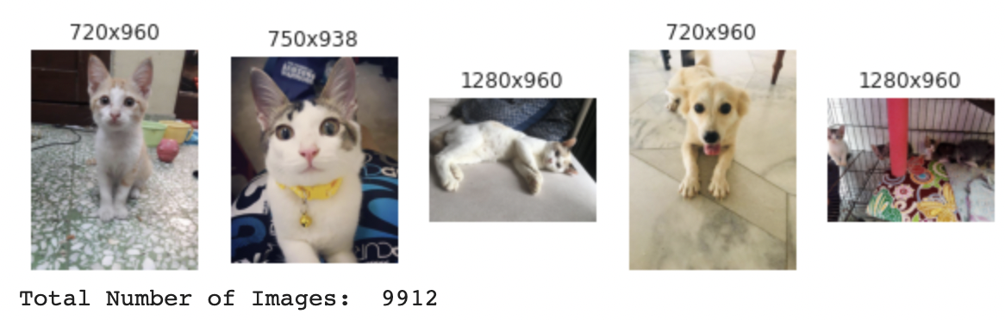
Input Data
Labels
Photo Metadata
“Pawpularity” Score
Scale from 1-100.
Derived from each pet profile’s page view statistics such as traffic and unique clicks.
Represents in this research, the likelihood of a pet getting adopted.
Images

Slide 4
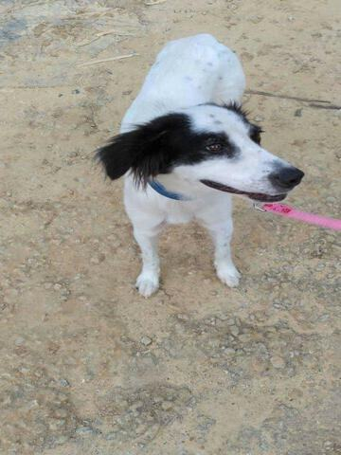

Data Cleaning & Processing: Image Data
Images are of different resolutions and orientations.
Most common aspect ratio is 3:4.
Tradeoff: either maintain original aspect ratio and have images of different resolutions, or stretch all images to a common aspect ratio.
We chose to reshape each image in our train and test data sets to 90x120.
Goal is to extract the major visual features of the image without getting too much into the details.
90x120
Notes:
We used the open source ImageMagic tool to perform the image processing offline to avoid running out of container resources on CoLab.
This is based on the same open source code as the python libraries used in the examples, just running as standalone command-line tools.
We tried multiple resolutions and aspect ratios and this is another parameter we can experiment with along with the other hyperparameters for kernel, stride, etc.

Slide 5
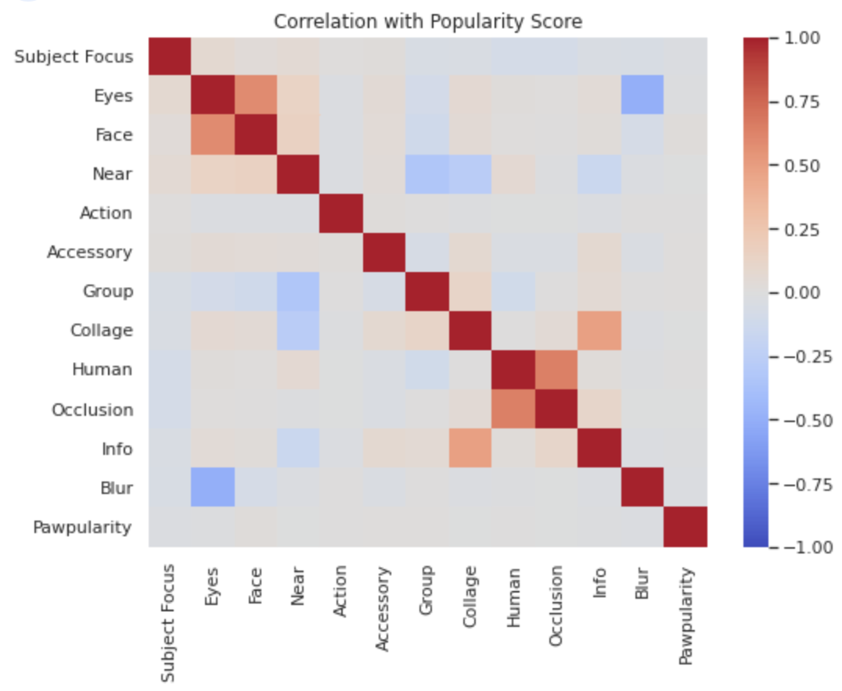
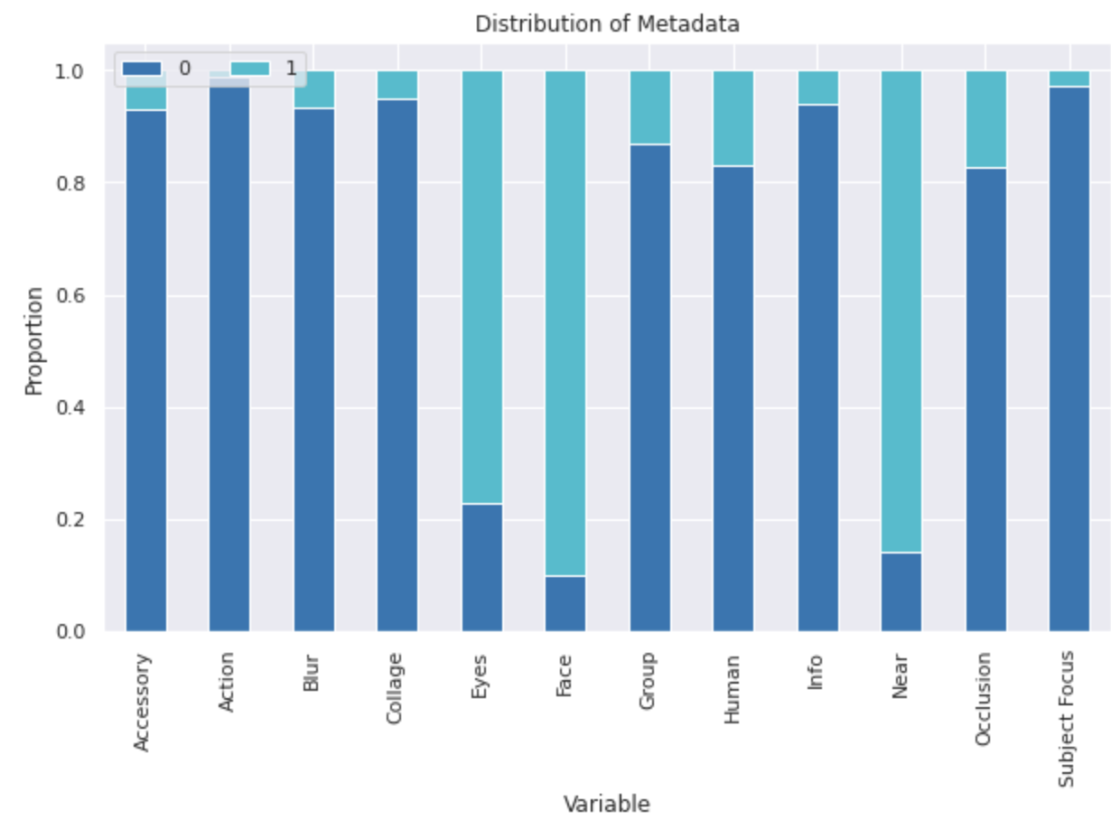
Exploratory Data Analysis: Image Metadata Inputs
Many images in the dataset are similar across the metadata features; this may make it challenging to predict pet popularity based on these metadata features alone.
Some of the metadata features are strongly correlated with each other; this makes sense given the context of these features.

Slide 6
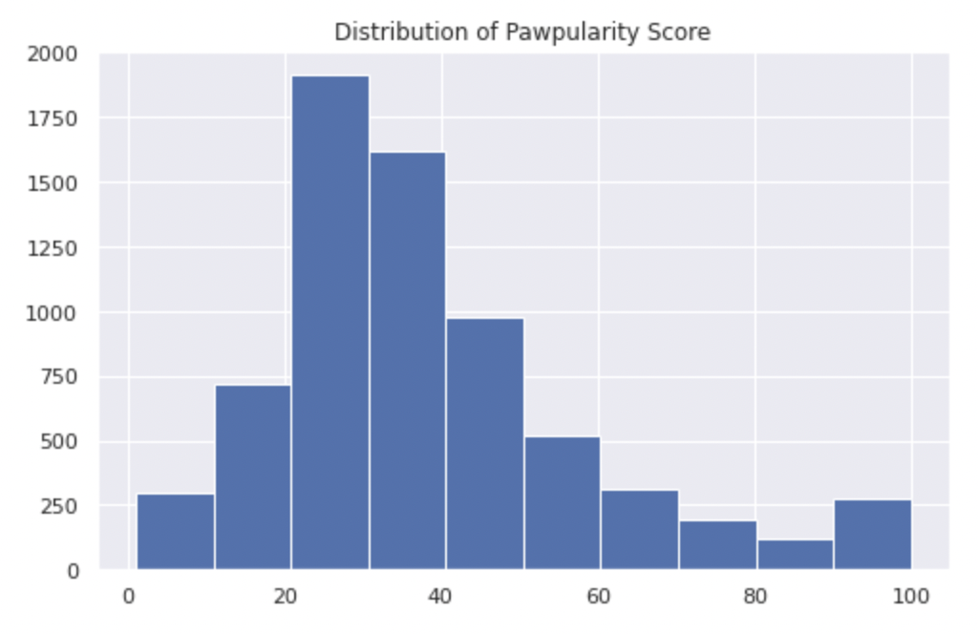
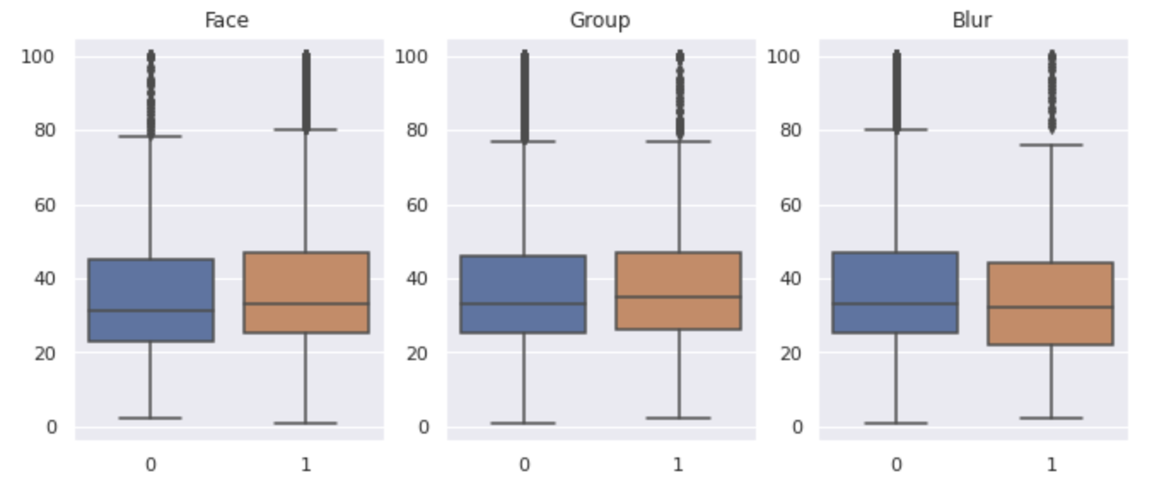
Exploratory Data Analysis: Popularity Score
Distribution of Metadata Variable with Popularity Score
None of the metadata variables appear to have a particularly strong or obvious relationship with popularity score. Face, blur and group appear most strongly related to popularity; this is consistent with a 2015 study conducted on dog adoption photos in the US.
Popularity score is roughly normally distributed with a mean of 38 and median of 33.

Slide 7
Exploratory Data Analysis: Popularity Score
We explore the highly popular images at the end of the histogram. We consider highly popular images as those images which have a popularity score > 98
Popularity score is roughly normally distributed with a mean of 38 and median of 33.

Slide 8
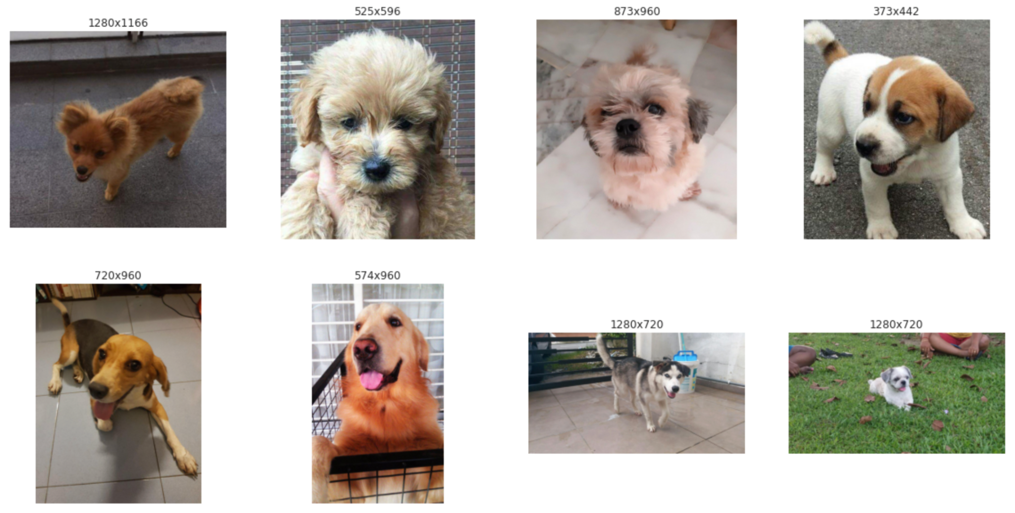
Highly popular photos
~3% of photos in training data are highly popular
Pet facing the camera, facial features are visible
80:20 ratio of dogs vs cats in the highly popular category from clustering results

Slide 9
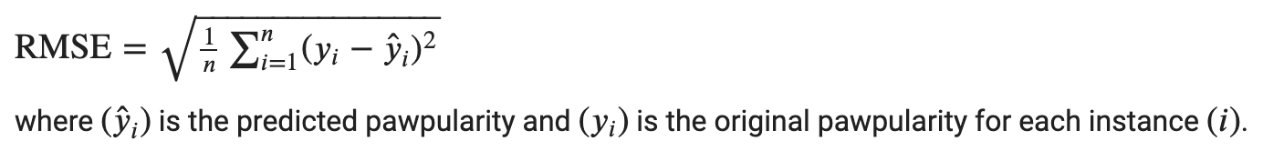
Evaluation Metric & Modeling Plan
Evaluation Metric
We will use the RMSE to evaluate the performance of our models, given that our predicted variable is a continuous value (in the range of 1 - 100).
RMSE is defined as:
Modeling Plan
Baseline: linear regression with metadata only
Model #1: linear regression with metadata and extracted image features
Model #2: linear regression on images
Model #3: CNN on images

Slide 10
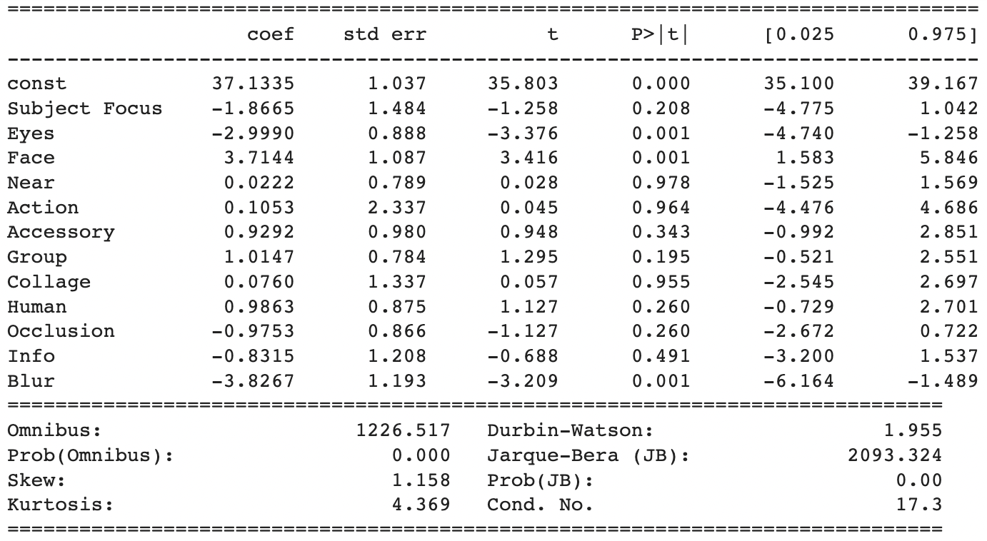
Baseline: linear regression on metadata
RMSE values for our model are high
Consistent with EDA, the features Eyes, Face, and Blur are significant according to the model, with p-values less than 0.05
RMSE
Train | 20.60
Validation | 20.58
Test | 20.31

Slide 11
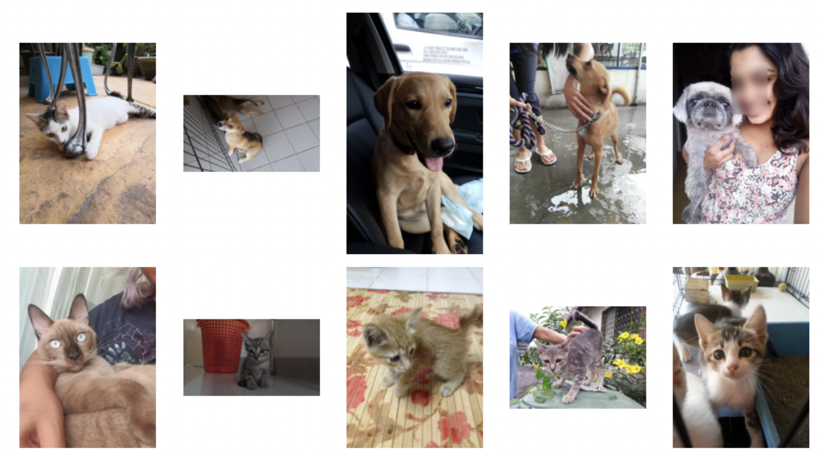
Feature extraction: Dog vs Cat classification
Used transfer learning model InceptionV3 trained on ImageNet for feature extraction from images
Use extracted features to perform k-means clustering
Average dog popularity: 40.8
Average cat popularity: 34.5
Dog cluster
Cat cluster

Slide 12
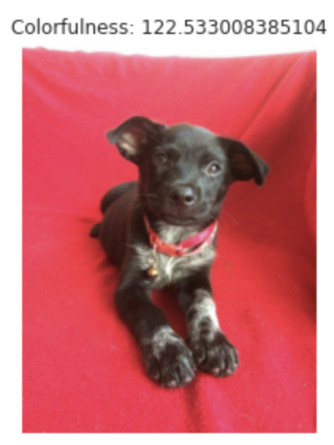
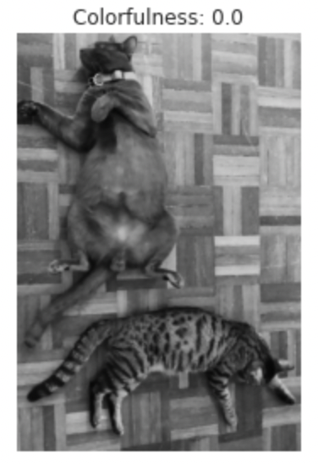
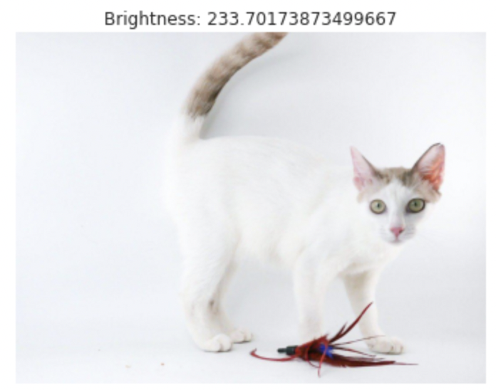
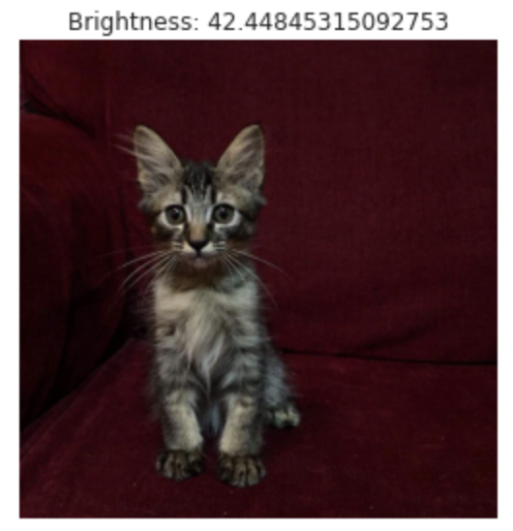
Model #1: linear regression on metadata with extracted features
isDog feature was added to the photo metadata based on clustering results
The model with isDog feature performs marginally better than baseline
Brightness and Colorfulness attributes were also extracted from the images
The model with isDog, Brightness and Colorfulness performs the same as baseline

Slide 13
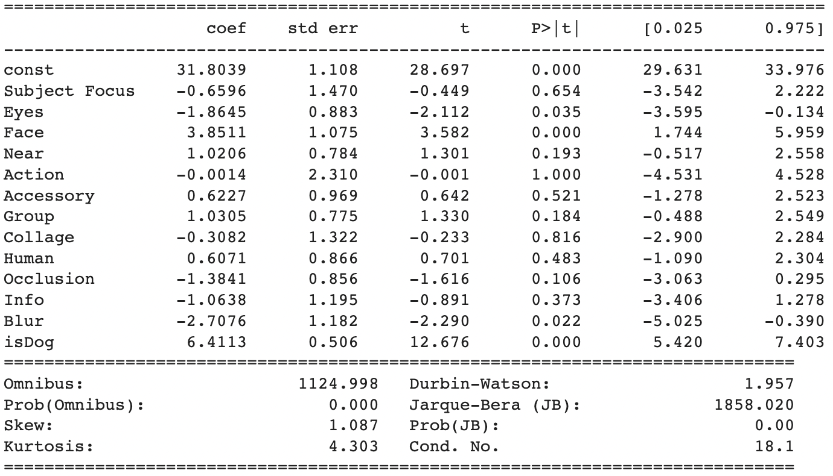
Model #1: linear regression on metadata with extracted features
RMSE
Train | 20.37
Validation | 20.32
Test | 20.13

Slide 14
Model #2: linear regression on images
Linear regression on the image pixels results in high levels of overfitting
Training input shape = (6,938, 90, 120, 3)
Trained on ~7000 images each with 32,400 features
Too many features for the number of images
Applied Lasso regularization to address overfitting
Regression on image data does not appear to add meaningful benefit beyond baseline
 | RMSE pre Regularization | RMSE post Regularization
Train | 0.06 | 20.64
Validation | 43.27 | 20.58
Test | 44.87 | 20.28

Slide 15
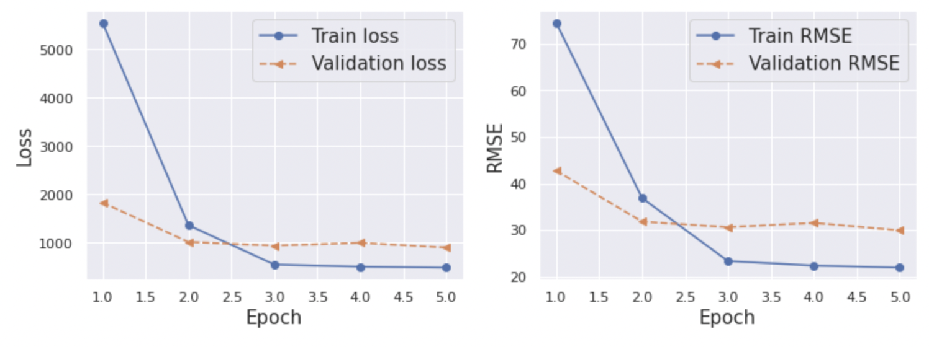
Model #3: CNN with images
Initial Model Build
2 convolutional layers with kernels of size 5 x 5 and strides of 1, 1
Each convolutional layer is followed by a max pooling layer with a pool size of 2, 2
Final fully connected layer has a linear activation
We leverage an Adam optimizer and do 5 epochs through the data with batch size 128
Initial Model Performance
RMSE is higher than linear regression models
Train RMSE drops after the first epoch and remains relatively steady
Little noise in validation RMSE
Tuning kernel size, strides, pooling size, learning rate and augmenting the image may improve model performance
Train RMSE: 21.95
Val RMSE: 29.95

Slide 16
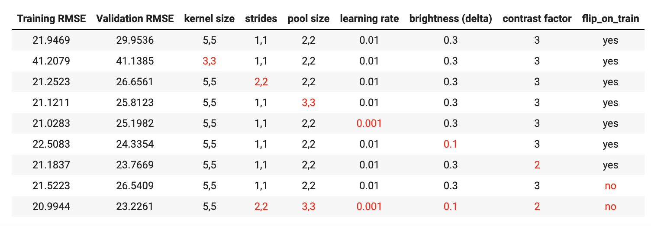
Model #3: CNN with images
RMSE
Train | 20.99
Validation | 23.23
Test | 22.81
Hyperparameter tuning
Hyperparameters were adjusted one at a time to assess impact on train and validation RMSE.
Adjusting the strides, pool size, learning rate, and image brightness / contrast / orientation resulted in a slightly better RMSE.
Final CNN Performance
We were able to improve performance through tuning hyperparameters.
CNN still performs slightly worse than the linear regression models.

Slide 17
Modeling Results Summary
Model | RMSE
 | Train | Validation | Test
Baseline | 20.6 | 20.58 | 20.31
Baseline + engineered features | 20.37 | 20.32 | 20.13
Linear regression on image data | 20.64 | 20.58 | 20.28
CNN on image data | 20.99 | 23.23 | 22.81

Slide 18
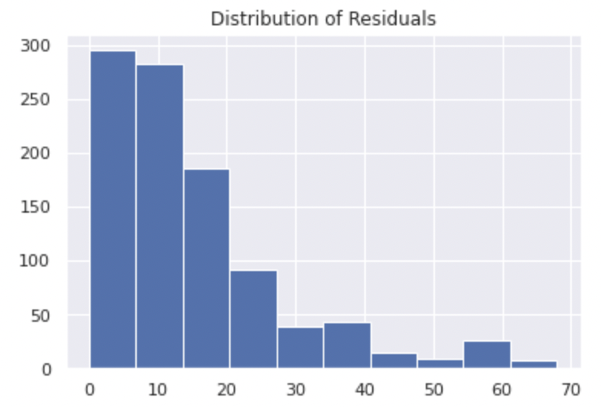
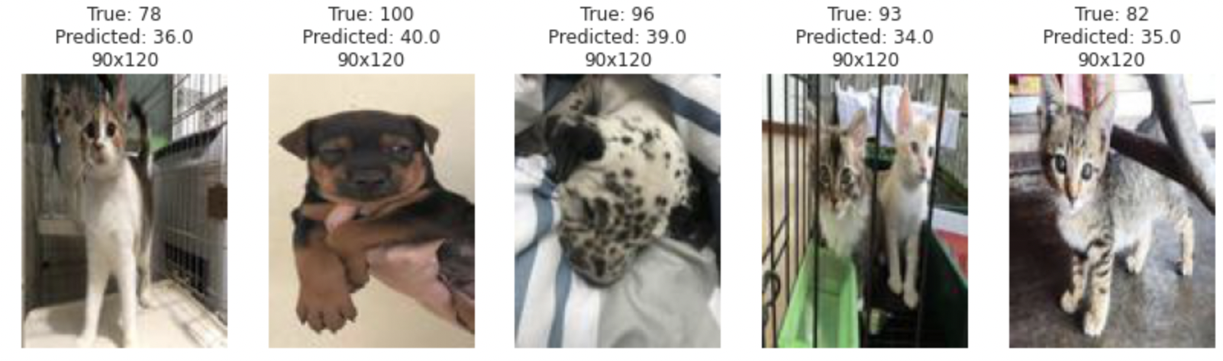
Final Model: Analysis of Errors
Key Takeaways
~60 images had a residual > 40
Hypotheses:
Highly popular images don’t have detectable key differentiating factors
Added blur when resizing these images may also have impacted our ability to accurately extract features from them
Potential next steps:
Bucket scores into H / M / L popularity
Explore other image resizing methods
Large Residual Images

Slide 19
Takeaways & Next Steps
All 4 of our models performed relatively similarly with an RMSE in the range of 20-23.
The CNN model in particular has many more hyperparameters that can be further tuned to enhance model performance. We explored kernel size, strides, pool size, and image augmentation, but only scratched the surface of the available techniques we could apply.
Linear regression provides interpretable insight into the characteristics of the most likeable pets in the data; the CNN is more opaque in translating to human understandable feedback about the characteristics of the image data that define likeability.
Next steps for the linear regression might be to bucket scores into H / M / L and run a logistic regression and explore other image resizing methodologies.
It would be interesting to extract other pet traits, such as their furriness and breed, and add those to the linear regression.
Moving forward, it would be helpful to understand the relationship between popularity score and time to pet adoption. In particular, if there is a wide range of popularity scores associated with the same general adoption time, this may impact the interpretation of our model’s RMSE.

Slide 20
References
https://towardsdatascience.com/image-clustering-using-k-means-4a78478d2b83
https://pyimagesearch.com/2017/06/05/computing-image-colorfulness-with-opencv-and-python/
https://stackoverflow.com/questions/3490727/what-are-some-methods-to-analyze-image-brightness-using-python
http://compositesupport.mementopix.com/support/solutions/articles/12000052997-images-brightness-contrast-color-and-other-properties-
https://www.analyticsvidhya.com/blog/2019/08/3-techniques-extract-features-from-image-data-machine-learning-python/

Slide 21
Thank you

